Slide 1
Module 2 HAIL Program
This module provides an overview of the HAIL Process
and demonstrates how to set and achieve short term health goals

Slide 2
Module 2
Learning Outcomes
To understand the concepts of the HAIL program
To recognize the steps involved in the HAIL process
To learn how to set and achieve short term health goals using the HAIL process

Slide 3
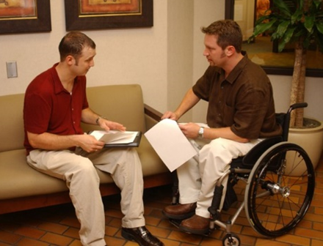
Contents
Components of the HAIL program
Steps involved in implementing HAIL
Practice with examples

Slide 4
What Are the Components of the HAIL Program?
The HAIL website and database
Worksheets and supports for consumers to problem-solve and choose solutions to try
Research measures to assess impacts-conducted by the HAIL staff

Slide 5
Let’s HAIL!

Slide 6
Steps of The HAIL Process
Step 1: Identify Short Term Health Needs
Step 6: Review Achievement
Step 2: Find Resources
Goals get more specific
Step 5: Track Goal Progress
Step 3: Define Goals
Step 4:
Develop Plan of Action

Slide 7
Step 1: Identify Short Term Needs
ILS asks consumer to Identify Short Term Health Needs
Consumer identifies needs related to Secondary Conditions (pain, fatigue, depression)
Consumer identifies needs related to Consumer Skills
Not able to identify ?
Complete the checklist and find ideas
Primary responsibility of ILS
Primary responsibility of Consumer

Slide 8
Step1: Identify Short Term Needs
Example
Maria sustained a stroke a few years ago and is in constant pain. She is unable to stand by herself and cannot to move her right hand. Her current medications don’t relieve the pain fully and Maria is ready to try something new. When her ILS asks her about a health goal she would like to pursue, she mentions wanting try other additional non-medical ways to deal with her pain.
Identify Short Term Health Needs: What secondary condition/consumer skill do I want to address?
PAIN

Slide 9
Step 2: Finding Resources
ILS assists consumer to find resources
Consumer explores beyond the HAIL website (friends, family, peer, and other support networks)
Consumer explores the HAIL website (http://hail.ku.edu)
Not able to find resources ?
Consumer asks CIL/ILS
Primary responsibility of ILS
Primary responsibility of Consumer

Slide 10
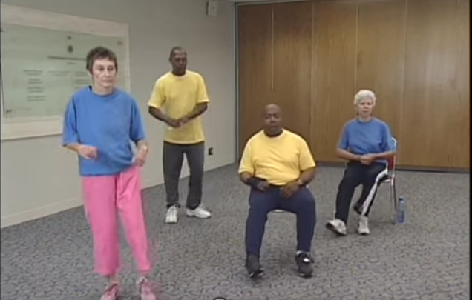
Example
Step 2: Finding Resources
Maria and the ILS explore the HAIL website and identify exercise as a way to strengthen muscles to reduce pain.
They discover an article on exercises for people with mobility impairment.

Slide 11
Step 3: Define Goals
Setting SMART Short-Term health goals in HAIL is important. Ask yourself if your goal is SMART?:
S: Is the goal specific?
M: Is the goal measurable?
A: Is the goal achievable or realistic?
R: Is the goal relevant to your health needs?
T: Is the goal time bound? (short term)
Notes:
Provide an example for each aspect of SMART.

Slide 12
Step 3: Define Goals ctd.
ILS asks consumer to define goals
Consumer defines Outcome Goal
What is the end result I would like to see in the area I have chosen within a given time frame ?
Consumer defines
Process Goal
What do I need to do toward achieving my outcome goal ?
Remember!
The goals have to be related to the needs identified in step 1
The process goals should be SMART
Primary responsibility of ILS
Primary responsibility of Consumer

Slide 13
Step 3: Define Goals - Example
Maria decides to try to reduce her pain through exercise instead of taking additional medications. The ILS helps Maria define her outcome goal and process goals.
Outcome Goal: What is the end result I would like to see in the area I have chosen within a given time frame ?
Reduce pain to a more acceptable level without additional medications.
Process Goal: What do I need to do toward achieving my outcome ?
I will exercise 30 minutes daily, 3 times weekly, for 8 weeks.
Notes:
Insert here a screenshot of the SMART goals worksheet?

Slide 14
Step 4: Outline A Plan of Action
ILS asks consumer to outline a plan of action
Action Plan
What do I need to do to achieve my process goal?
Back Up plan
What obstacles do I envision in achieving my action plan ?
How will I overcome the obstacle?
Think!
Convert your goals into doable actions
Think about obstacles you might face
Primary responsibility of ILS
Primary responsibility of Consumer

Slide 15
The ILS helps Maria to devise a plan to achieve her goal. The ILS also helps Maria think of barriers that might prevent her from pursuing her plan.
Step 4: Outline a Plan of Action- Example
Action Plan
What do I need to do to achieve my goal?
I will do resistance training and strength training for 30 minutes daily, 3 times weekly, for 8 weeks.
Back-up Plan
What obstacles do I envision in achieving my process goal?
I sometimes get busy with other things and don’t make time to exercise.
How will I overcome the obstacle ?
I will schedule time to exercise first thing in the morning before I get busy.

Slide 16
Step 5: Track Progress
ILS asks the consumer to track goals using the HAIL SMART Goal Tracking Form
Primary responsibility of Consumer
Primary responsibility of ILS
Consumer track progress using the HAIL SMART Goal Tracking Form

Slide 17
Step 6: Review
ILS asks consumer to review progress
Consumer is prompted to ask
“Was I able to achieve my process goal?”
Consumer is prompted to ask
“What barriers prevented me from doing it?”
Consumer is prompted to ask
“What can I do differently to be successful?”
Primary responsibility of Consumer
ILS and Consumer repeat the process on the same goal or a different one.
Primary responsibility of ILS

Slide 18
Step 6: Review– Example
ILS helps Maria review her progress with the following questions:
Was I able to achieve my process goal?
Yes, most of the time.
What barriers prevented me from doing it ?
Some days I did not feel like exercising .
What can I do differently the next time?
I have read that sometimes working out with a partner helps to stick with my exercise. Hence, I will ask my friend Stacy to exercise with me.

Slide 19
Let’s Talk!
What parts of these steps can we weave into the program you already use with your consumers?

Slide 20
General Tips for Consumers
Empowering Consumers
Set Short Specific goals
Find a support system that encourages you
Understand your strengths and limitations
Persevere when confronted with barriers
Try other solutions
Find a way to track your progress
Don’t give
up!
Trust
yourself!

Slide 21
Any Questions?

